Slide 1
Machine Learning Approach to Raman Spectral Classification
Jesse Levine
Supervisor: Li-Lin Tay
Notes:
Alright so good morning everyone. I’ll be going through the evolution and the work that I have done so far during my work term on the machine learning raman spectral classification project.
I’ll discuss the foundational work of identifying pure chemicals, discuss the iterative improvements I made, and then transition to the more complex challenge of analyzing chemical mixtures, as well as touch on SERS classification although, as we’ll see I have so far mainly focused on standard raman classification.

Slide 2

Goal
Core Problem: Can we reliably identify an unknown chemical from its Raman spectrum by matching it against a reference library?
Inspiration: Facial Recognition
Notes:
The fundamental goal of this project is to create a system that can reliably and automatically identify an unknown chemical from its Raman spectrum by matching it against a reference library of known chemicals.
The primary inspiration for tackling this began with a 2023 paper from the Halas Group at Rice University, published in
ACS Nano. They developed a machine learning algorithm to classify Surface-Enhanced Raman, or SERS, spectra by matching them against a library of standard Raman spectra. To frame the problem, they introduced the concept of ‘spectral recognition,’ which is analogous to facial recognition.
Just as facial recognition algorithms can identify a person from a new photo—even if it's grainy, at a different angle, or has poor lighting—by comparing it to a database of clear portraits, the Halas paper aimed to do the same for spectra. They wanted to identify a noisy and variable SERS spectrum by matching it to a clean, standard Raman spectrum in a library. This powerful analogy of creating a robust matching system that can handle real-world variations guided our entire approach to this project, from our initial feature extraction methods to our final model selection.

Slide 3
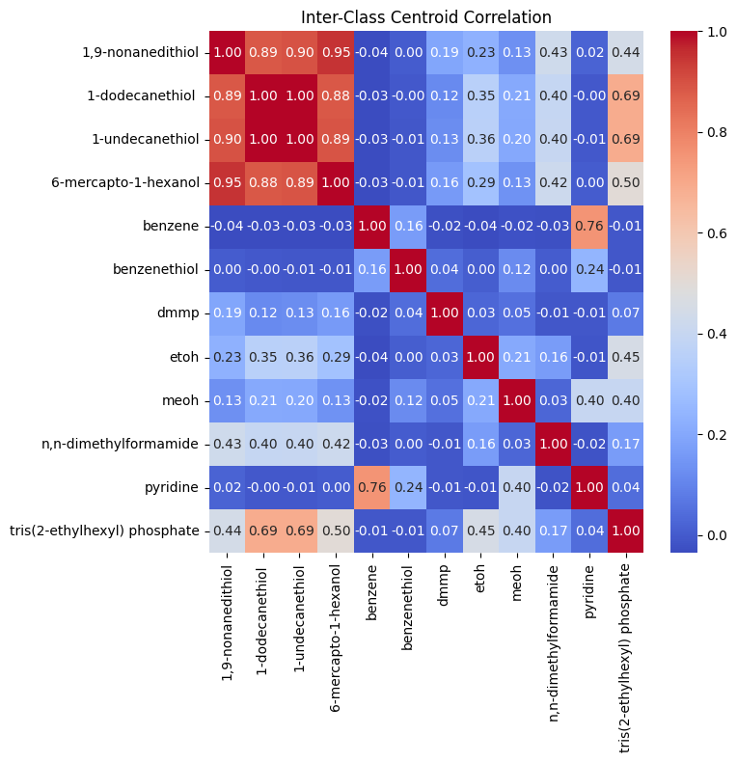
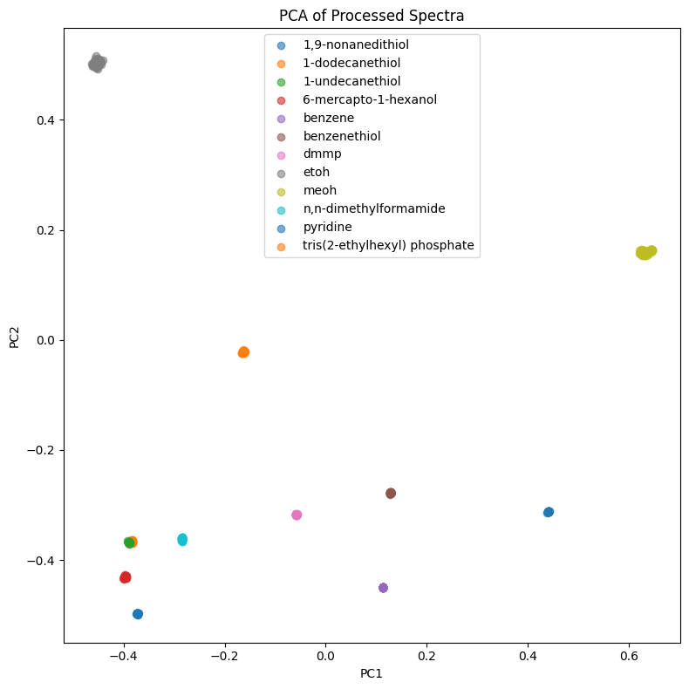
Initial Exploration: PCA
Top 5 contributing features for PC1: 1033.9 cm⁻¹ loading = 0.294 1031.6 cm⁻¹ loading = 0.281 1036.2 cm⁻¹ loading = 0.279 1038.5 cm⁻¹ loading = 0.253 1029.2 cm⁻¹ loading = 0.241
Top 5 contributing features for PC2: 883.8 cm⁻¹ loading = 0.337
886.2 cm⁻¹ loading = 0.316
881.5 cm⁻¹ loading = 0.288
888.6 cm⁻¹ loading = 0.247
879.1 cm⁻¹ loading = 0.205
Explained variance by component: PC1: 33.42% PC2: 21.35%
Notes:
Before delving into any model building I wanted to see just how different or separable the Raman data is. To do so I used Principal Component Analysis, which is a dimensionality reduction technique. It takes high dimensional data and projects into a 2-D space which captures the maximum possible variance.
These results were pretty interesting, because, aside from the Thiol groups and mercapto being extremely similar, all the chemicals are quite differentiable in terms of their Raman spectra, however something that was of note is that you’ll notice most of the data within each class forms a dot, as if each example within each class is nearly identical, as if there’s nearly zero variance between each example within each class, something that might have repercussions later for mixture classification and for SERS to raman classification. Because remember the way that the problem is framed is: given an unknown query chemical can we identify it from a reference dataset of known standard raman spectra. And if the standard raman data are nearly identical to each other within each class for every example it could be that downstream the models and algorithms are overfit on the data and cant generalize to mixtures or SERS.

Slide 4
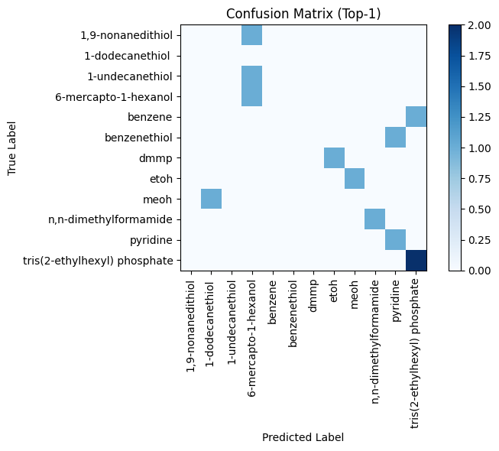
Characteristic Peak Similarity (CaPSim)
CaPE → Dot Product
Top 1: 41.67%
Top 2: 75%
Top 3: 83.33%
Notes:
So then I worked on implementing the exact algorithm from the Halas paper, called CaPSim. First is Characteristic peak extraction or CaPE. Using CaPE to identify the most consistent and intense ‘characteristic peaks’ for each chemical/class. Acting as the spectral ‘fingerprint’.
Then secondly calculate the dot-product between the fingerprint vector of the query spectrum and each reference spectrum. The highest score is the predicted match.
I could not replicate the results from the paper however clearly there was some promise to the method as when returning the top 3 most similar chemicals as calculated using CaPSim , the actual chemical was present 83.3% of the time but the most similar was predicted less than half, which is not great.

Slide 5
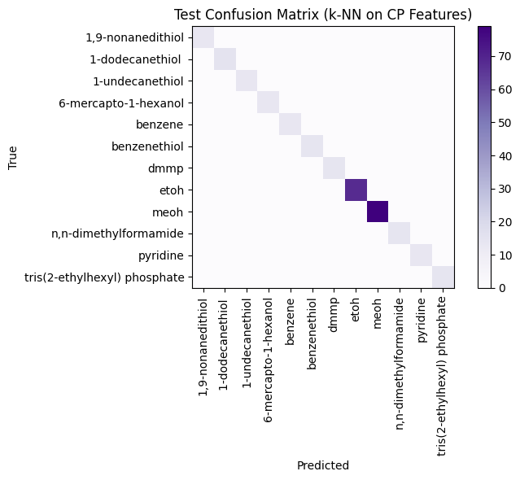
Improvement #1: CaPSim-kNN
Improvement: Replace dot-product with kNN classifier
Top 1: 100%
Notes:
The first improvement I did was then replace the dot-product with a more robust classifier.
Instead of a dot-product I extract all the characteristic peak vectors and create a unified feature vector and train a k-nearest-neighbours classifier.
kNN models classify a new data point based on the majority class of its ‘k’ nearesdt neighbors in the feature space.
This resulted in a top-1 accuracy of 100%, meaning the predicted most similar chemical was always correct.

Slide 6
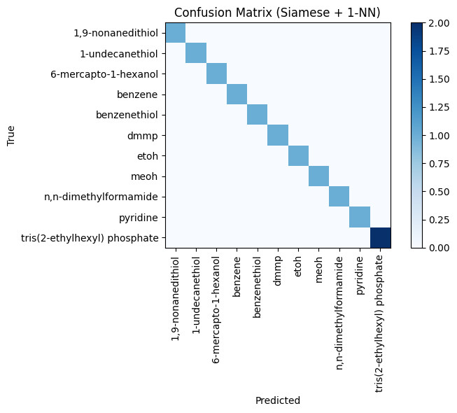
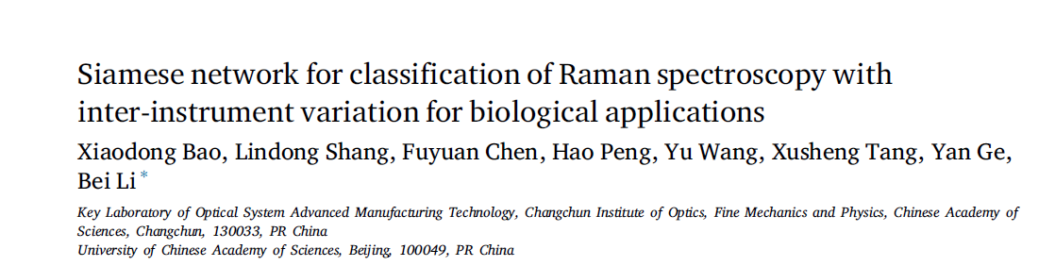
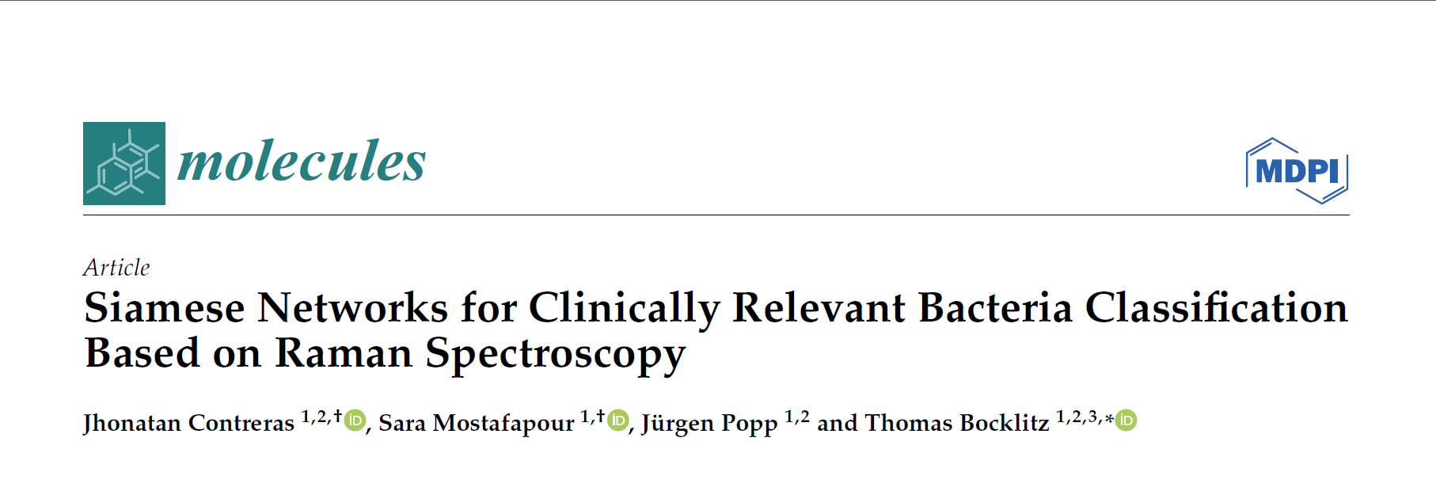
Improvement #2: Siamese Network
Notes:
If you read the Halas paper, the way that they frame the problem of ‘nuisance’ variations from SERS substrates and identifying SERS spectra from a dataset of reference standard raman and being inspired by facial recognition models its as if they were describing whats known as a Siamese Network.
Siamese Networks are a deep learning architecture principally utilized for facial recognition, but have been used for Raman as you can see in these two papers, and specifically in what is called ‘One-Shot’ learning: where the model is trained on very few examples or even makes use of a reference dataset of one example per class.
A Siamese Network consists of two identical neural nets, trained on pairs of spectra and during training it learns to generate a low-dimensional embedding for each spectrum such that embeddings of the same class are very close in vector space and embeddings from different classes are far apart.
Instead of learning to directly classify each chemical’s spectrum, it learns the most optimal similarity metric.
This approach achieved 100% accuracy as well.

Slide 7
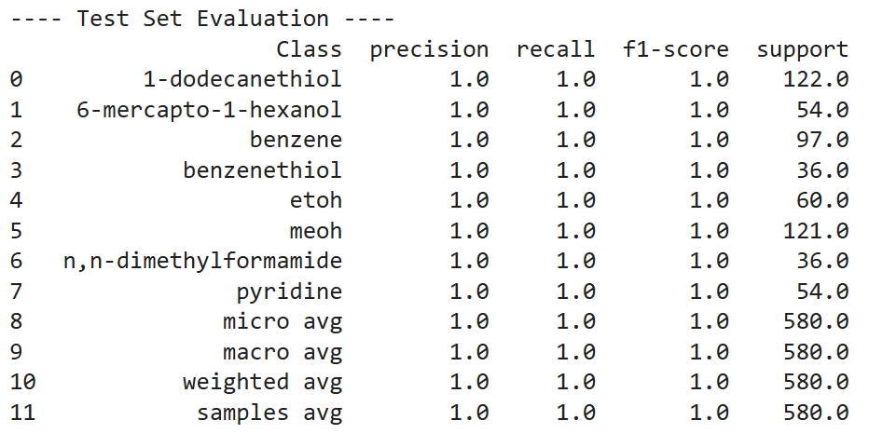
New Challenge: Mixtures
First Approach: Multilabel Classification
CaPSim-kNN
Limitation: Not generalizable to unseen mixtures
100% Accuracy
Notes:
I then moved onto chemical mixtures where the goal is to identify individual components within a single, mixed signal.
I began by framing the problem as a classic multilabel classification problem: teach the model to output ‘present’ labels for a single spectrum.
I retrained the CaPSim-kNN model as a mulilabel classifier and this worked as well, the only problem is that this method isn’t generalizable to unseen mixtures of the same chemicals in the reference dataset.
And at this point my eyebrow started raising at the perfect performance.

Slide 8


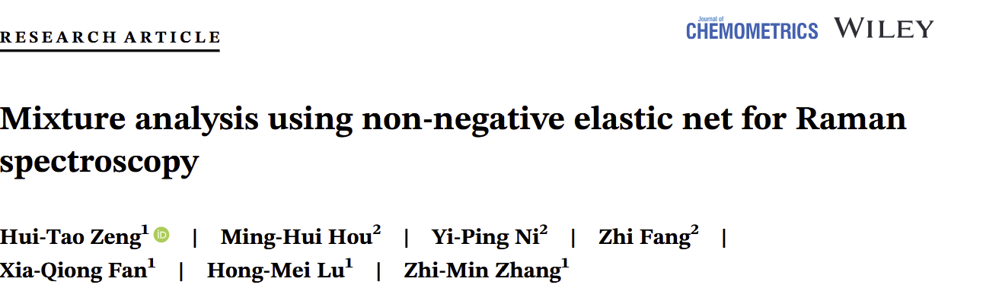
Mixtures 2.0 - Deconvolution+Meta-Classification
Non-Negative ElasticNet (Regularized NNLS) to “unmix”
Output: “Weights” vector estimating contribution of each pure chemical to mixture
Meta-Classification
Train meta-classifier → “Present” Or “Absent”
Test Set F1 Score: ~94%
Notes:
However I attempted to build a generalizable solution. Inspired by this 2020 paper on mixture analysis using non-negative elastic net. They looked at using ElasticNet to quantify mixtures.
The first step is deconvolution. From this paper, I used Non-negative ElasticNet, which is a form of regularized non-negative least squares, to ‘unmix’ the query spectrum.
For those that don’t know regularization is a technique that adds penalty to the model during training to discourage overly complex models and help prevent overfitting by constraining the values of the parameters. ElasticNet is one regularization technique, it combines both whats called L1 and L2 regularization.
Anyhow, the output of this unmixing step is a ‘weights’ vector where each weight estimates the contribution of a pure chemical to the mix.
Step two is Meta-classification. I train a bank of binary Random Forest Models, one per class, on the weights vector to ultimately predict whether a pure chemical is present given a new unseen weights vector.
This seemingly worked well with an F1 score, on the test set, of 94%, however, looking under the hood I noticed that at the unmixing step, this method wasn’t good at estimating the contribution of both chemicals in the spectrum and often only ogt one of them correct.

Slide 9
Current rabbit hole
OVERFITTING? WHY? WHERE?
Quantification + Classification
Siamese Net for Mixtures?
SERS classification from pure Raman
Notes:
Finally this leads me to the current rabbit holes I am down.
So far I have focused on standard Raman classification but the original goal as explained in that original Halas paper was SERS classification from standard raman.
However a prelimimary look at the SERS data is that it tends to be extremely noisy and my hypothesis is that my models that performed perfectly are essentially overfit to clean standard raman and wont generalize to the SERS data.
I am also looking into whether the Siamese Network approach can be used for mixtures and the ElasticNet solution has me interesting in seeing if I can also reliably predict concentrations and quantifying chemical mixtures and not just simply identifying wich chemicals are present.

